Slide 1

Smart College Management System-UniSphere
Streamlining academic and administrative operations for colleges.
Improving accessibility for students, faculty, and administrators.

Slide 2
Introduction
What is a College Management System?
Why is it needed?
Our Solution
To enhance efficiency and accessibility in college operations.
An integrated system to streamline operations and improve user experience.
A centralized platform for managing academic and administrative tasks.

Slide 3

Problem Statement
Challenges in College Management
Traditional Systems
Lack of integration and accessibility.
Inefficient data handling.
Our Solution
Addresses inefficiencies with an integrated approach.

Slide 4
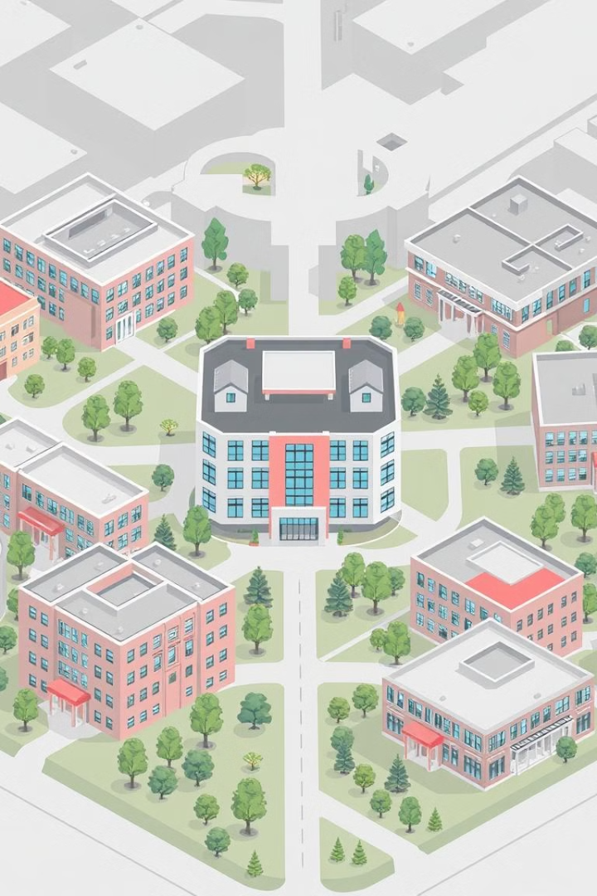




Core Features
User Roles
Enrollment
Course Management
Admin, Faculty, Student access.
Student admissions and profiles.
Faculty assignment, scheduling.
Attendance Tracking
Digital monitoring for students/faculty.

Slide 5

Technology Stack
Frontend
Next.js
Backend
Django, Node.js.
Database
SQL
.

Slide 6
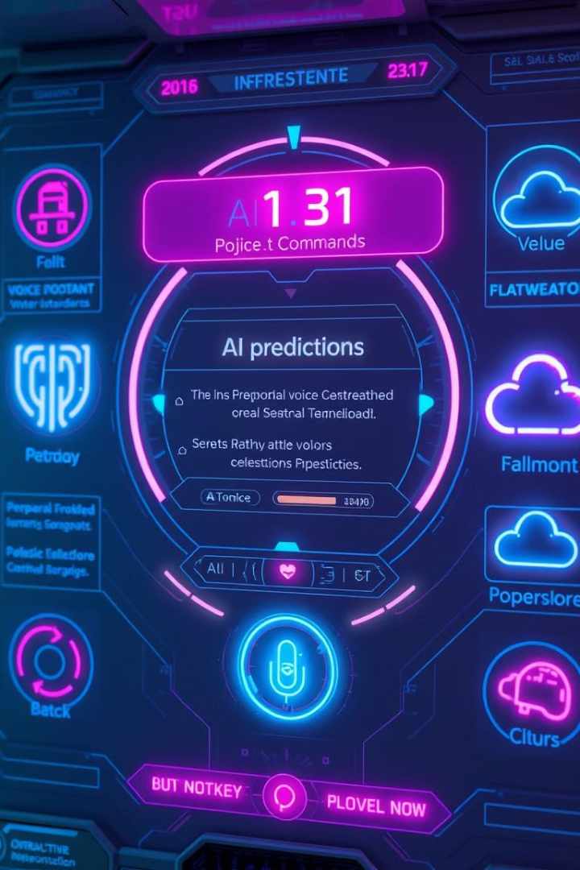



Bonus Features
AI Attendance
Prediction & alerts.
Voice Assistant
Quick timetable access.
Cloud Storage
Assignments & materials.

Slide 7
The Team
Rishmeet Singh
Pranjal Kaushik
Aadya Srivastava
Ishita Singh Ayushman Tripathi
Dedicated to innovation and excellence

Slide 8

Conclusion
Project Summary
Impact
Integrated College Management System.
Improved efficiency and accessibility.
Thank You

